Slide 1
Spanning Trees

Slide 2
Spanning Tree
For a graph G=(V,E) a spanning tree is
a subgraph of G that is
an undirected tree and contains
all the vertices of G.

Slide 3
Minimum Spanning Tree
In a weighted graph G=(V,E,W), the weight of a subgraph is
the sum of the weights of the edges in the subgraph.
A minimum spanning tree for a weighted graph is
a spanning tree with the minimum weight.

Slide 4
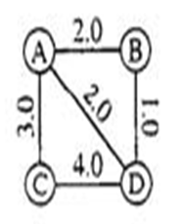
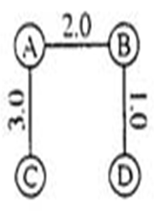
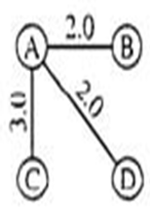
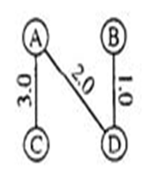
Minimum Spanning Tree

Slide 5
Minimum Spanning Tree
Definition: Minimum spanning tree property
Let a connected, weighted graph G=(V,E,W) be given, and let T be any spanning tree of G.
Suppose that for every edge [u,v] of G that is not in T,
If [u,v] is added to T, then it creates a cycle such that [u,v] is a maximum-weight edge on that cycle.
Then the tree T is said to have the minimum spanning tree property.

Slide 6
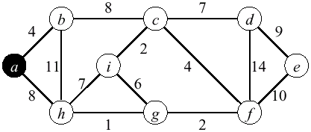
Kruskal’s Minimum Spanning Tree Algorithm

Slide 7
Kruskal’s Minimum Spanning Tree Algorithm
Edge | Source | Destination | Weight
e1 | a | b | 4
e2 | a | h | 8
e3 | b | c | 8
e4 | b | h | 11
e5 | c | d | 7
e6 | c | i | 2
e7 | c | f | 4
e8 | d | e | 9
e9 | d | f | 14
e10 | e | f | 10
e11 | f | g | 2
e12 | g | h | 1
e13 | g | i | 6
e14 | h | i | 7

Slide 8
Kruskal’s Minimum Spanning Tree Algorithm
After Sorting with increasing order of weights
Edge | Source | Destination | Weight
e12 | g | h | 1
e6 | c | i | 2
e11 | f | g | 2
e1 | a | b | 4
e7 | c | f | 4
e13 | g | i | 6
e5 | c | d | 7
e14 | h | i | 7
e2 | a | h | 8
e3 | b | c | 8
e8 | d | e | 9
e10 | e | f | 10
e4 | b | h | 11
e9 | d | f | 14

Slide 9
Kruskal’s Minimum Spanning Tree Algorithm
Red – Creates a Cycle, Blue – Not considered, since maximum weighted
Edge | Source | Destination | Weight
e12 | g | h | 1
e6 | c | i | 2
e11 | f | g | 2
e1 | a | b | 4
e7 | c | f | 4
e13 | g | i | 6
e5 | c | d | 7
e14 | h | i | 7
e2 | a | h | 8
e3 | b | c | 8
e8 | d | e | 9
e10 | e | f | 10
e4 | b | h | 11
e9 | d | f | 14

Slide 10
Kruskal’s Minimum Spanning Tree Algorithm
void kruskal (int weight[][MAX])
{
int parent[MAX];
typedef struct { int v1,v2,wt;}edge;
edge e[15];
int i,j,k,size=0,nodecount;
for (i=0; i<MAX; i++)
parent[i]=-1;
for (i=0; i<MAX-1; i++)
for (j=i+1; j<MAX; j++)
if (weight[i][j] != INFINITY)
{
e[size].v1=i;
e[size].v2=j;
e[size].wt=weight[i][j];
size++;
}
for (i=0;i<size; i++)
printf("%d -- %d -- %d\n",e[i].v1+1,e[i].v2+1,e[i].wt);
for (i=0; i<size-1; i++)
for (j=i+1; j<size; j++)
if (e[i].wt>e[j].wt)
{
edge temp=e[i];
e[i]=e[j];
e[j]=temp;
}
printf("\n\n");
for (i=0;i<size; i++)
printf("%d -- %d -- %d\n",e[i].v1+1,e[i].v2+1,e[i].wt);
printf("spanning tree\n");
nodecount=1;

Slide 11
Kruskal’s Minimum Spanning Tree Algorithm
for (k=0; nodecount<MAX; k++)
{
i=e[k].v1;
j=e[k].v2;
while (parent[i]>-1) i= parent[i];
while (parent[j]>-1) j= parent[j];
if (i!=j)
{
parent[j]=i;
printf ("%d - %d\t%d\n",e[k].v1+1, e[k].v2+1,e[k].wt);
nodecount++;
}
}
}
void main()
{
int i, a[MAX][MAX] =
{
{100,8,3,5,100},
{8,100,100,9,100},
{3,100,100,7,4},
{5,9,7,100,2},
{100,100,4,2,100}
};
kruskal(a);
}

Slide 12
Kruskal’s Minimum Spanning Tree Algorithm
Kruskal's algorithm constructs a MCST incrementally.
Initially, each node is in its own MCST, consisting of that node and no edges.
At each step in the algorithm, the two MCST's that can be connected together with the least cost are combined, adding the lowest cost edge that links a vertex in one tree with a vertex in another tree.
When there is only one MCST that includes all vertices, the algorithm terminates.
Since we must consider the edges in order of their cost, we must sort them, which requires O(E log E). Merge can be implemented in O(E log E).
Kruskal's algorithm is O(E log E), which is better than Prim's algorithm if the graph is not dense (ie, E <= N²).

Slide 13
Prim’s Minimum Spanning Tree Algorithm
Select an arbitrary starting vertex, (the root)
attach the edge to the tree that has minimum weight among all edges that can be attached
add to the tree the vertex associated with the edge
During the course of the algorithm, vertices are divided into three disjoint categories:
Tree vertices: in the tree constructed so far,
Fringe vertices: not in the tree, but adjacent to some vertex in the tree,
Unseen vertices: all others

Slide 14
Prim's Algorithm Overview
Initially, Prim's algorithm has one node in the spanning tree, and no edges.
The algorithm adds nodes to the spanning tree one at a time, in order of the edge cost to connect to the nodes already in the tree.

Slide 15
Prim's Algorithm Overview
PrimMCST( set <edge> &T)
{
set <vertex> U;
/* T = set of edges in spanning tree */
T = NULL;
/* U = set of connected vertices so far */
U = {1};
while (U <> V)
{
/* Add least cost edge that adds node not in U */
(u,v) = lowest cost edge s.t. u in U, v in V-U
/* Add edge to spanning tree */
Insert(T,u,v);
/* Add v to set of connected vertices */
Insert(U,v);
}
Print(T);
}

Slide 16
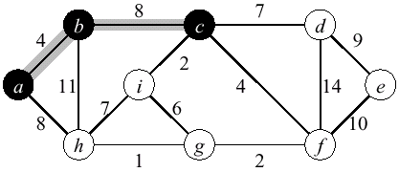
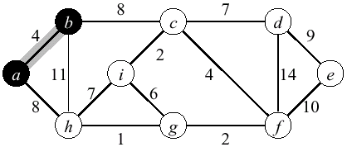
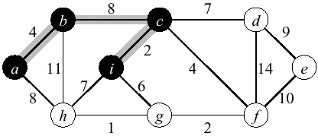
Prim Example 1

Slide 17
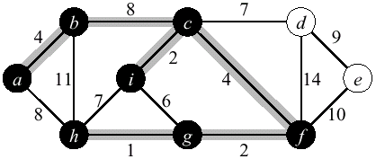
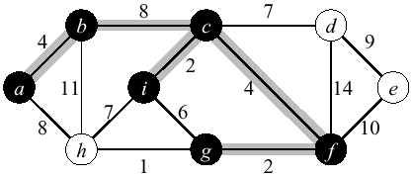
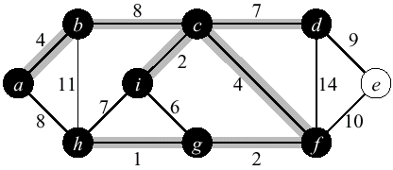
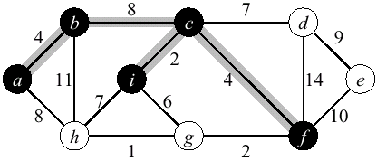
Prim Example 1 (Contd.)

Slide 18
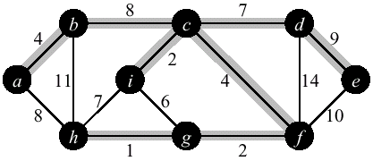
Prim Example 1 (Contd.)

Slide 19
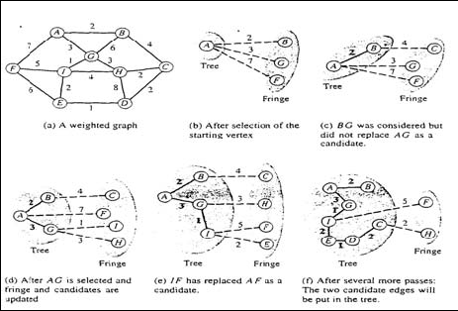
Prim Example 2

Slide 20
Analysis of Prim's Algorithm
Prim's algorithm is O(N²).
The while loop is executed n-1 times, requiring O(N)
We add one vertex to U each iteration
We exit the loop when U = V
We can find the lowest cost edge from U to V-U in O(N) time.

Slide 21
Kruskal’s v/s Prim’s
Prim's method starts with one vertex of a graph, and adds the smallest edge that grows tree by one more vertex.
Kruskal starts with all of the vertices of a graph as a forest, and adds the smallest edge that joins two trees in the forest.
Prim's method is better when
You can only concentrate on one tree at a time
You can concentrate on only a few edges at a time
Kruskal's method is better when
You can look at all of the edges at once
You can hold all of the vertices at once
You can hold a forest, not just one tree

Slide 22
END.

